Slide 1


Slide 2

Memory full
How do I get everything done?

Slide 3
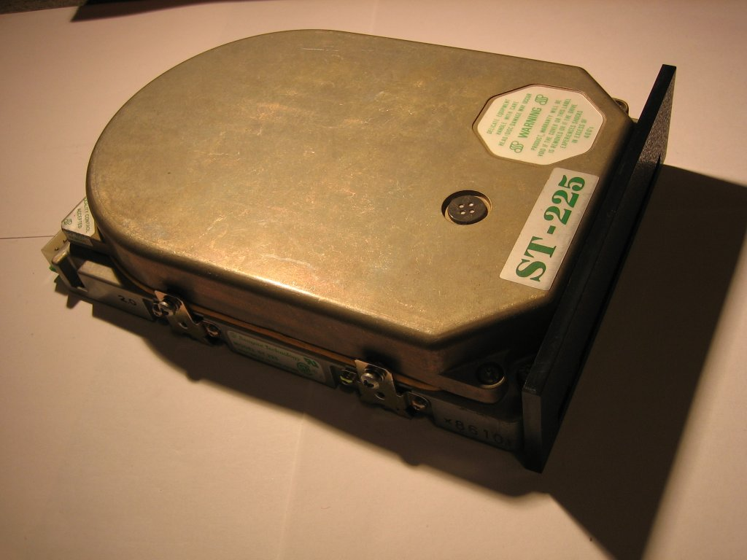

Slide 4
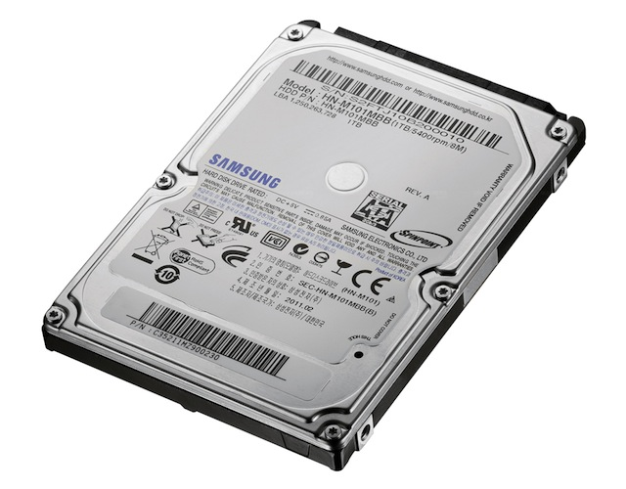

Slide 5
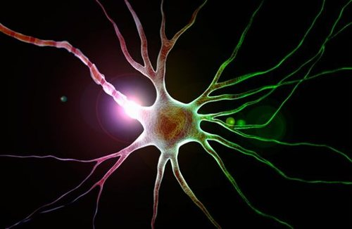

Slide 6
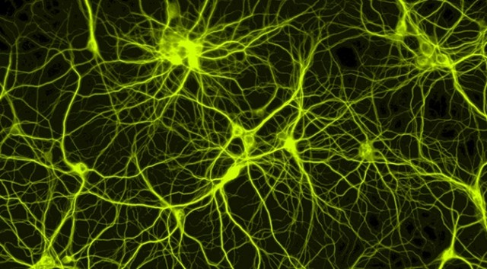

Slide 7
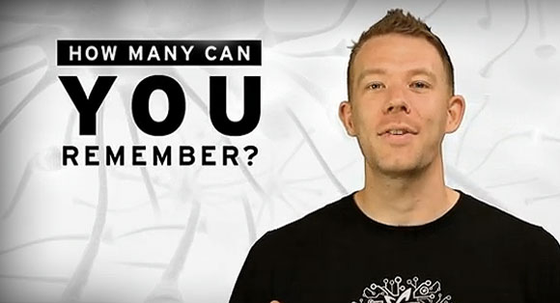
Nelson Dellis
USA memory champ
Memorized 313 digits in a row – 104 cards in order

Slide 8
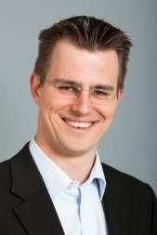
Boris Nikolai Konrad
World Memory champion
Memorized 280 words and 195 names and faces in 15 minutes!

Slide 9
²⁵﻿Daardie tyd het Jesus gesê: “Ek prys U, Vader, Here van hemel en aarde, dat U hierdie dinge vir slim en geleerde mense verberg het en dit aan eenvoudiges bekend gemaak het. ²⁶﻿Ja, Vader, so was dit u genadige bedoeling.

Slide 10
²⁷﻿“My Vader het alles aan My toevertrou, en niemand ken die Seun nie, behalwe die Vader; en ook ken niemand die Vader nie, behalwe die Seun en elkeen aan wie die Seun Hom wil bekend maak.
²⁸﻿“Kom na My toe, almal wat uitgeput en oorlaai is, en Ek sal julle rus gee. ²⁹﻿Neem my juk op julle en leer van My, want Ek is sagmoedig en nederig van hart, en julle sal rus kry vir julle gemoed. ³⁰﻿My juk is sag en my las is lig.”

Slide 11
Abruptly Jesus broke into prayer: “Thank you, Father, Lord of heaven and earth. You’ve concealed your ways from sophisticates and know-it-alls, but spelled them out clearly to ordinary people. Yes, Father, that’s the way you like to work.”
Jesus resumed talking to the people, but now tenderly. “The Father has given me all these things to do and say. This is a unique Father-Son operation, coming out of Father and Son intimacies and knowledge.

Slide 12
No one knows the Son the way the Father does, nor the Father the way the Son does. But I’m not keeping it to myself; I’m ready to go over it line by line with anyone willing to listen.
“Are you tired? Worn out? Burned out on religion? Come to me. Get away with me and you’ll recover your life. I’ll show you how to take a real rest. Walk with me and work with me—watch how I do it. Learn the unforced rhythms of grace. I won’t lay anything heavy or ill-fitting on you. Keep company with me and you’ll learn to live freely and lightly.”

Slide 13
REST

Slide 14
FOCUS

Slide 15


Slide 16
Prayer of the heart

Slide 17
“Lord Jesus Christ, Son of God,
Show me mercy, a sinner.”
Jesus prayer

Slide 18
Journaling

Slide 19
“Journaling is a way for you to be with God and your thoughts, not an exercise in language arts.”
Adele Calhoun

Slide 20
“For even young people tire and drop out, young folk in their prime stumble and fall.
But those who wait upon God get fresh strength.
They spread their wings and soar like eagles,
They run and don’t get tired, they walk and don’t lag behind.”
The Message

