Slide 1
Goeie Vrydag
Jesaja 52:13-53:12

Slide 2
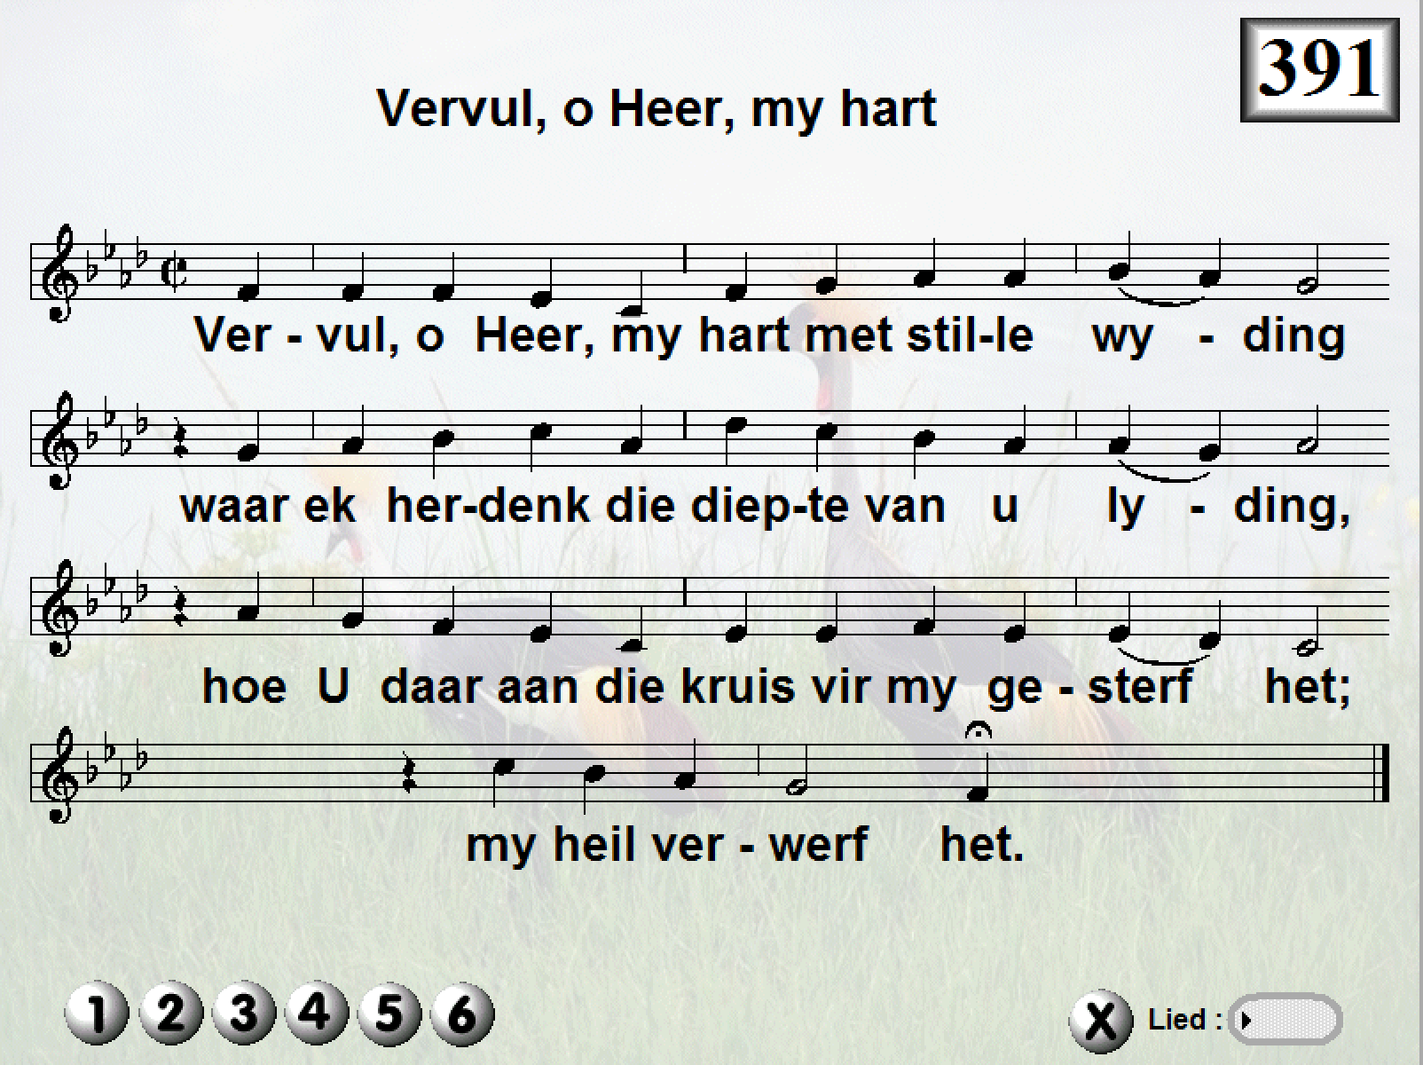

Slide 3
Votum
Voorganger: Here ontferm U oor ons.
Gemeente: Christus ontferm U.
Voorganger: Here ontferm U oor ons
Gemeente: en gee ons u vrede,

Slide 4
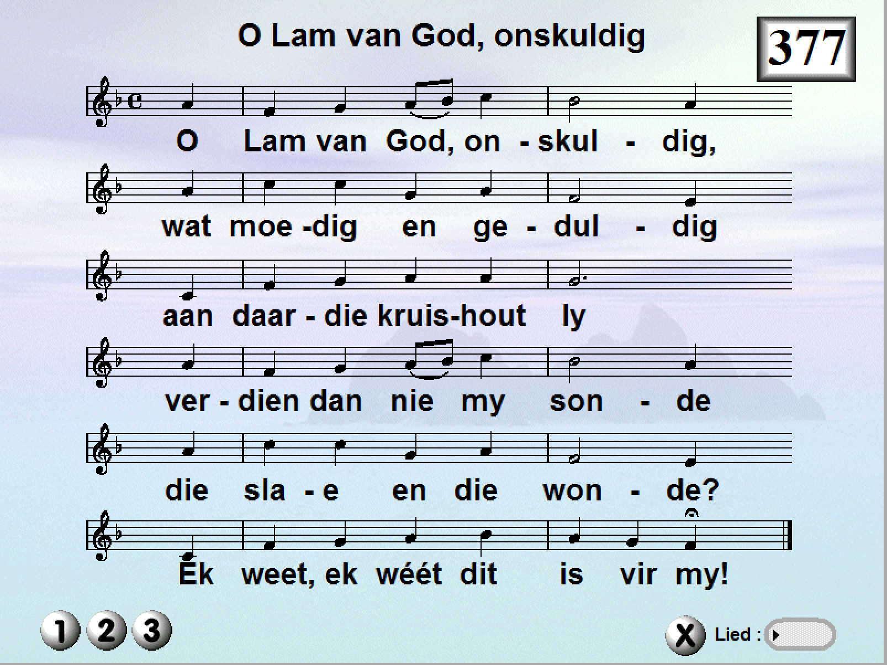

Slide 5
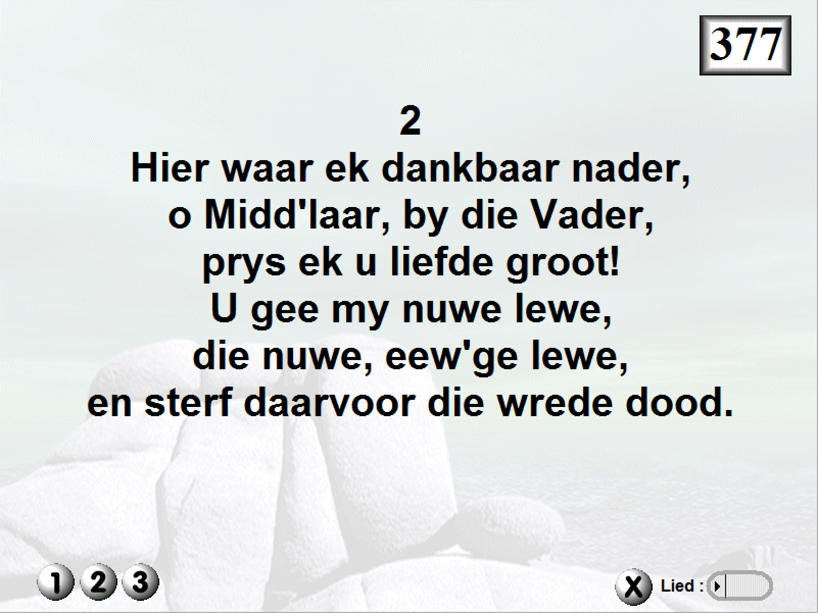

Slide 6
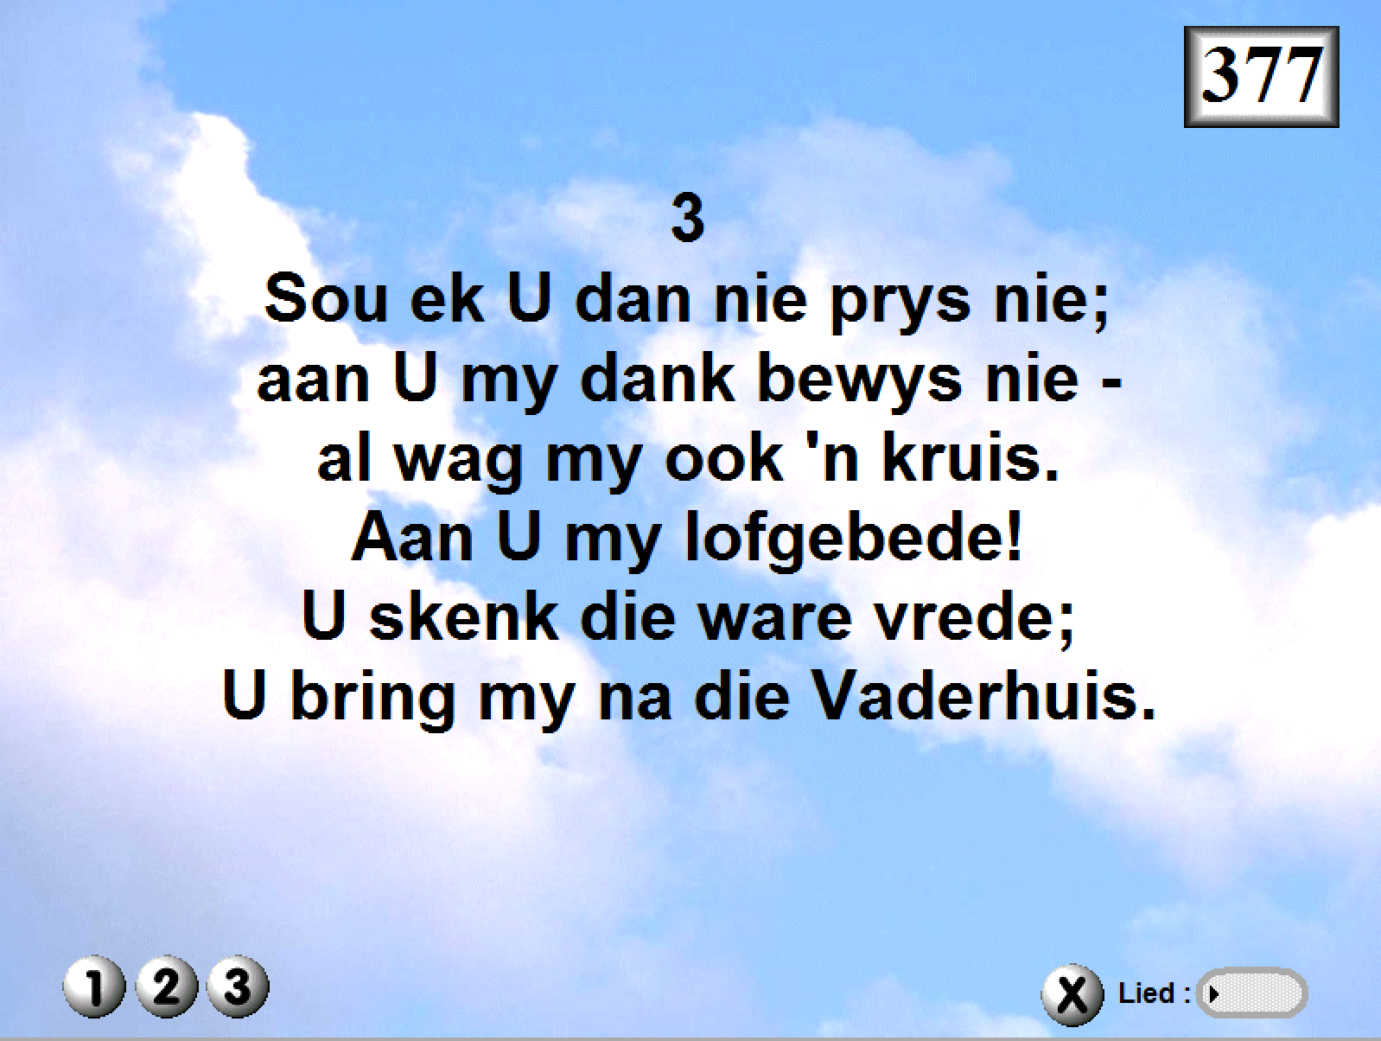

Slide 8
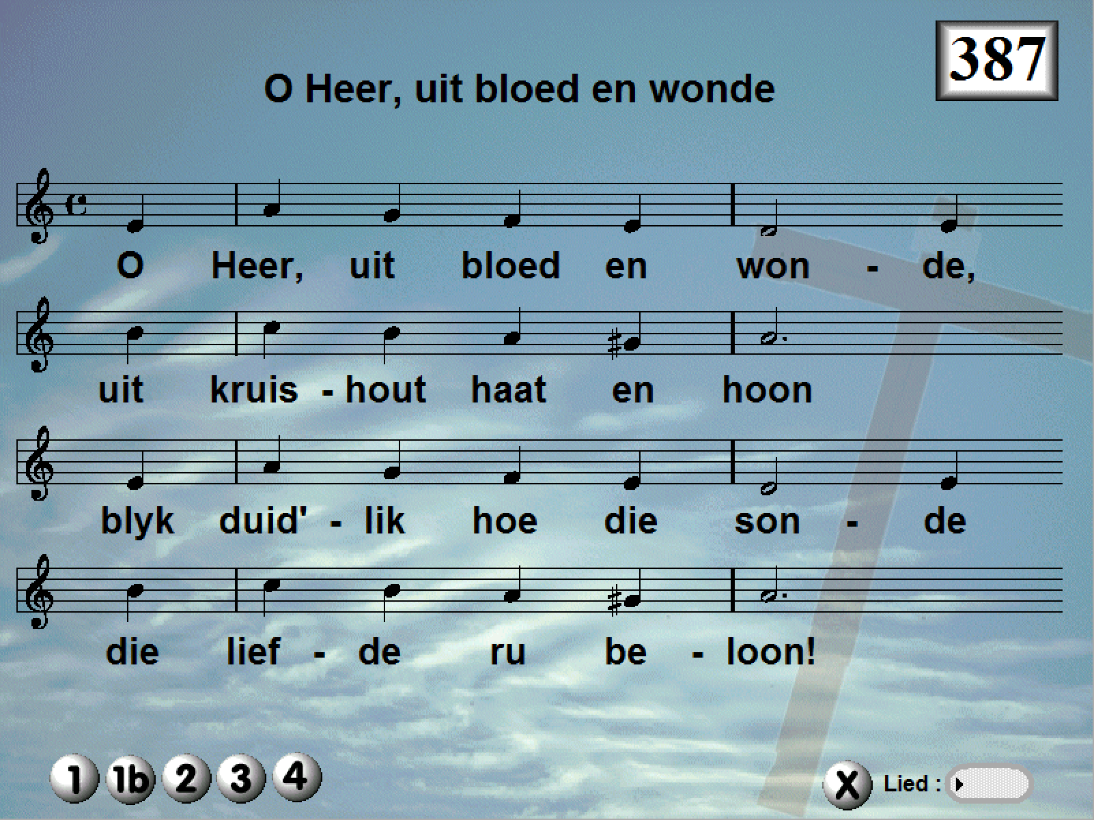

Slide 9
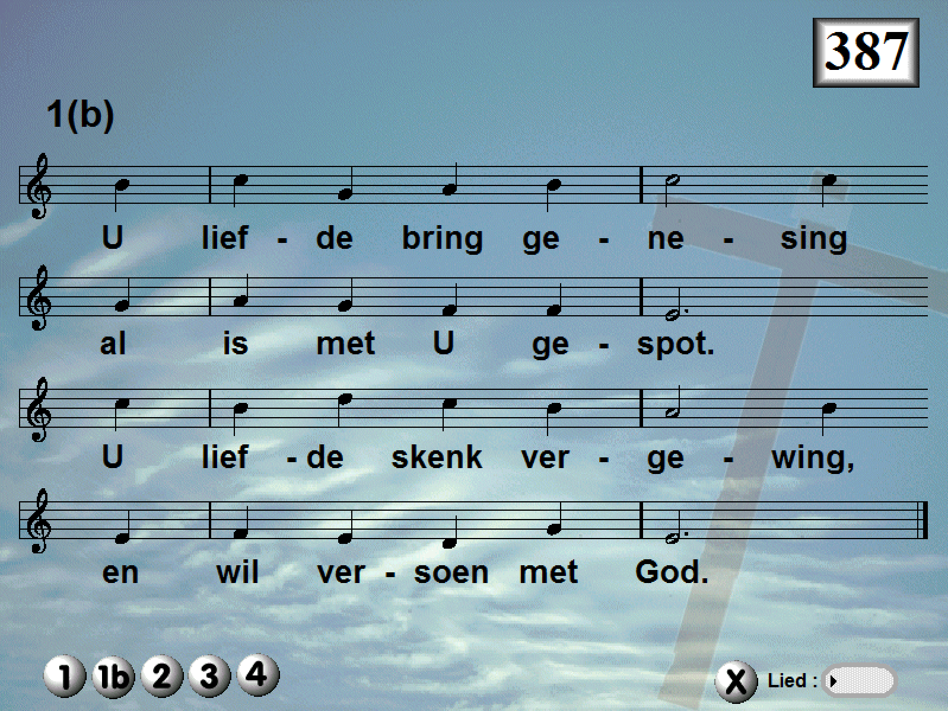

Slide 11
My dienaar sal wys wees. Hy sal hoog in aansien wees, hy sal baie eer ontvang. Baie mense was ontsteld oor hom, hy was só misvormd dat hy nie meer soos ’n mens gelyk het nie, nie meer die voorkoms van ’n mens gehad het nie. | ¹³See, my servant will act wisely; he will be raised and lifted up and highly exalted. ¹⁴Just as there were many who were appalled at him— his appearance was so disfigured beyond that of any man and his form marred beyond human likeness—

Slide 13
Maar hy gaan baie nasies laat opspring van verbasing. Konings sal sprakeloos wees oor hom, want hulle sal iets sien wat nie aan hulle vertel is nie, hulle sal iets te wete kom wat hulle nog nooit gehoor het nie. Wie sal ons glo as ons hiervan vertel? Wie sal die mag van die Here hierin kan raaksien? | ¹⁵so will he sprinkle many nations, and kings will shut their mouths because of him. For what they were not told, they will see, and what they have not heard, they will understand. ^{53:1}Who has believed our message and to whom has the arm of the Lord been revealed?

Slide 15
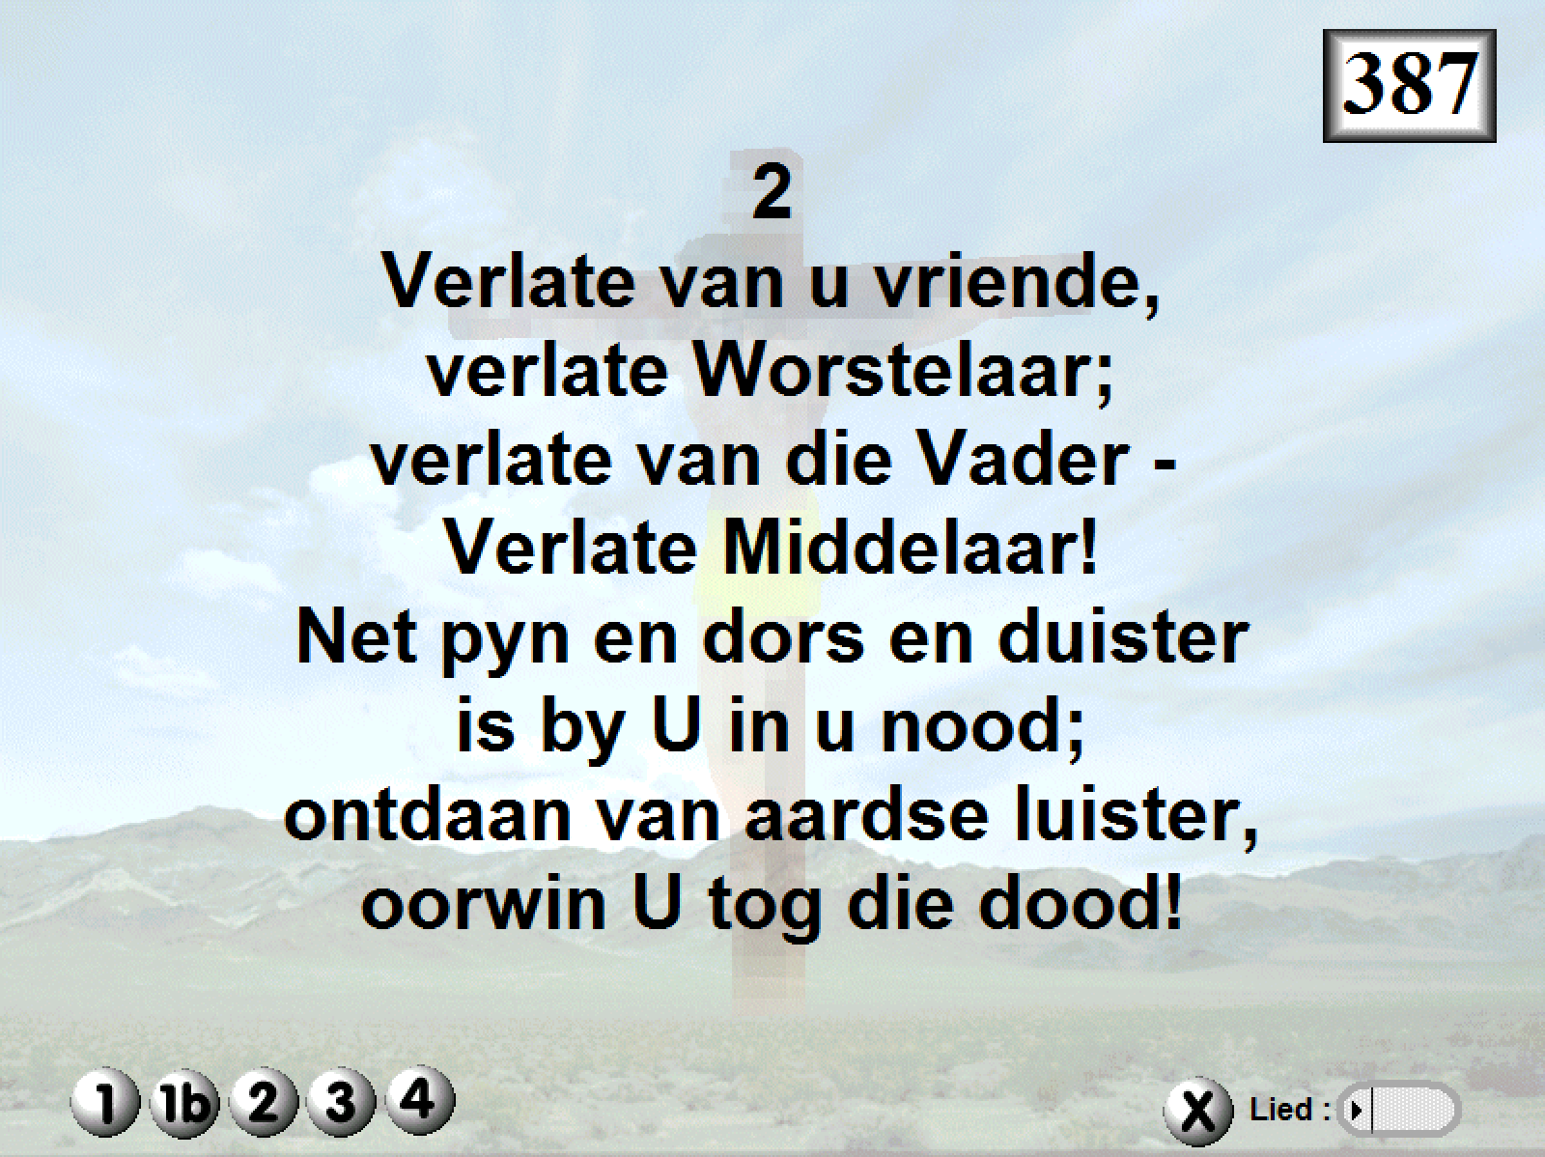

Slide 17
Terwyl hy gely het en gestraf is, is hy weggeneem, en wie van sy mense het dit ter harte geneem dat hy afgesny is uit die land van die lewendes? Hy is gestraf oor die sonde van my volk. Hy het ’n graf gekry by goddeloses, hy was by sondaars in sy dood al het hy geen misdaad gepleeg nie en al was hy nooit vals nie. Dit was die wil van die Here om hom te verbrysel. om hom die pyn te laat ly. | ¹⁵so will he sprinkle many nations, and kings will shut their 8By oppression and judgment he was taken away. And who can speak of his descendants? For he was cut off from the land of the living; for the transgression of my people he was stricken. 9He was assigned a grave with the wicked, and with the rich in his death, though he had done no violence, nor was any deceit in his mouth. 10Yet it was the Lord’s will to crush him and cause him to suffer,

Slide 19
As hy sy lewe as skuldoffer gee, sal hy ’n nageslag hê en nog lank lewe, deur hom sal die wil van die Here sy doel bereik. Ná sy bitter lyding sal hy weer die lig sien en hy sal die Here ken. | and though the Lord makes his life a guilt offering, he will see his offspring and prolong his days, and the will of the Lord will prosper in his hand. 11After the suffering of his soul, he will see the light of life and be satisfied;

Slide 21
Goeie Vrydag
Vandag is daar geen klokke nie
lui geen angelus:
die wêreld hou sy asem in
by die kruisiging van Jesus –
nee, anders is die waarheid
in ritme en in rym:
die wêreld drink sy wyn in die son
en niemand dink aan Hom –
O onpeilbare vademlose
diep geheimenis:
dat krummels en ’n kring op ’n tafel
daardie agonie werd is.

Slide 23
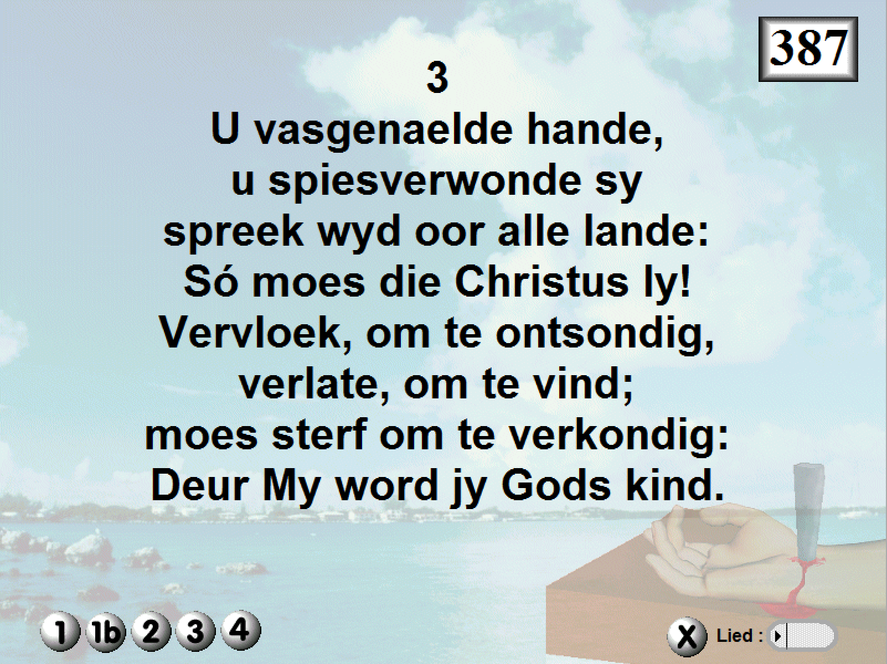

Slide 25
Hy is mishandel, maar hy het geduldig gebly, hy het nie gekla nie. Soos ’n lam wat na die slagplek toe gelei word en soos ’n skaap wat stil is as hy geskeer word, het hy nie gekla nie. | 7He was oppressed and afflicted, yet he did not open his mouth; he was led like a lamb to the slaughter, and as a sheep before her shearers is silent, so he did not open his mouth.

Slide 27
12Daarom gee Ek hom ’n ereplek onder die grotes. Hy sal saam met magtiges oorwinning vier omdat hy hom in die dood oorgegee het en as misdadiger beskou is, omdat hy die sondes van baie op hom geneem het en vir oortreders gebid het. | Therefore I will give him a portion among the great, and he will divide the spoils with the strong, because he poured out his life unto death, and was numbered with the transgressors. For he bore the sin of many, and made intercession for the transgressors.

Slide 29
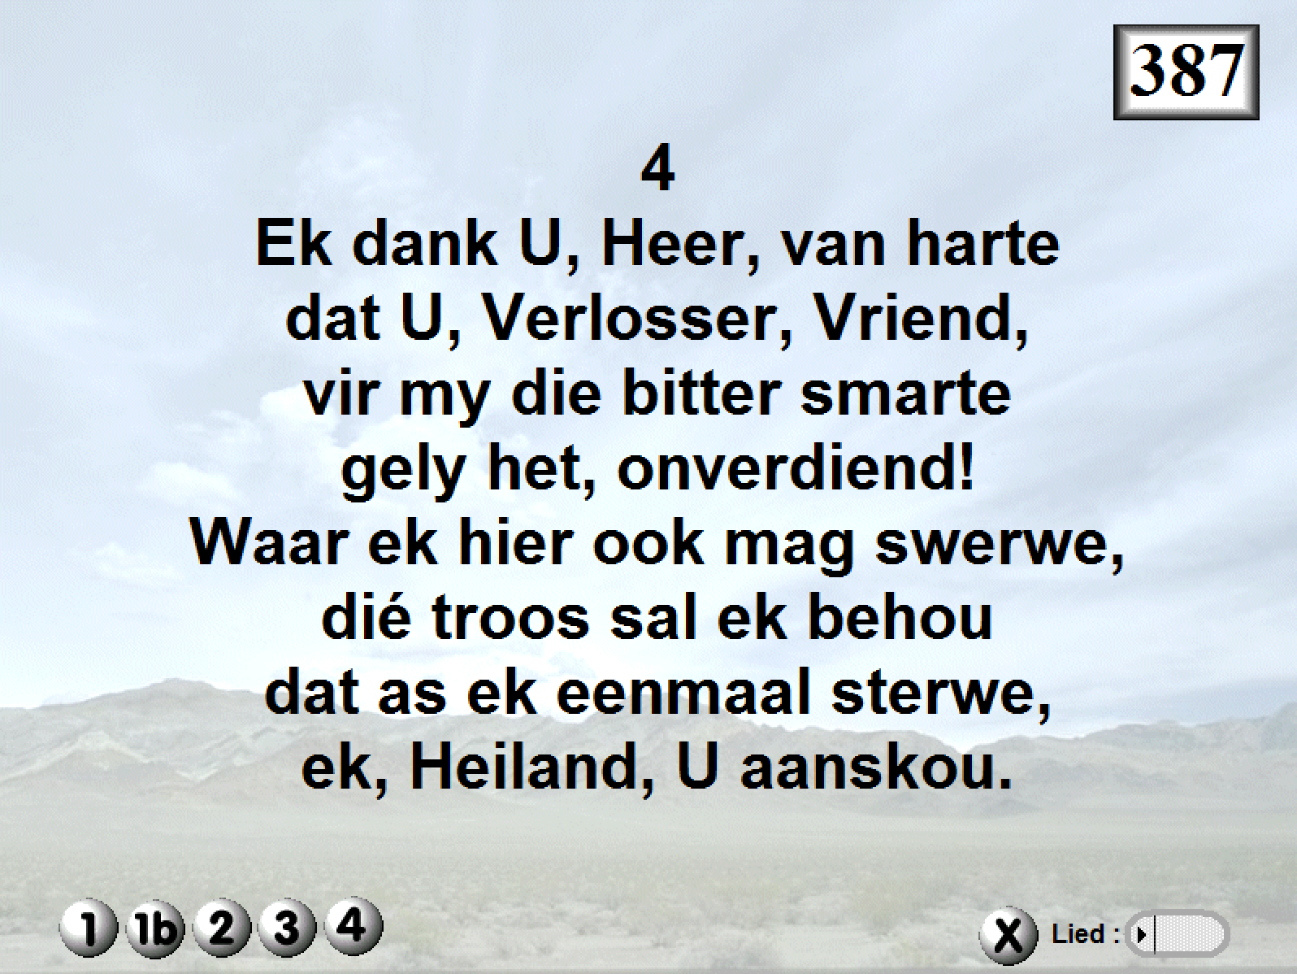

Slide 31
Daarom gee Ek hom ’n ereplek onder die grotes. Hy sal saam met magtiges oorwinning vier omdat hy hom in die dood oorgegee het en as misdadiger beskou is, omdat hy die sondes van baie op hom geneem het en vir oortreders gebid het. | Therefore I will give him a portion among the great, and he will divide the spoils with the strong, because he poured out his life unto death, and was numbered with the transgressors. For he bore the sin of many, and made intercession for the transgressors.

Slide 32
"Ek sê vir julle: Die Skrifwoord wat sê: 'En Hy is as misdadiger beskou,' moet aan My bewaarheid word, want wat op My betrekking het, gaan nou in vervulling." | 37 It is written: ‘And he was numbered with the transgressors’; and I tell you that this must be fulfilled in me. Yes, what is written about me is reaching its fulfillment.”

Slide 34
19﻿Broers, ons het dus nou deur die bloed van Jesus vrye toegang tot die heiligdom, 20﻿en dit op ’n weg wat nuut is en na die lewe lei. Hierdie weg het Hy vir ons gebaan deur die voorhangsel heen, dit is deur sy liggaam. 21﻿En terwyl ons Hom ook as groot priester oor die huis van God het, 22﻿laat ons tot God nader met ’n opregte hart en met volle geloofsekerheid. | 19 Therefore, brothers, since we have confidence to enter the Most Holy Place by the blood of Jesus, 20 by a new and living way opened for us through the curtain, that is, his body, 21 and since we have a great priest over the house of God, 22 let us draw near to God with a sincere heart in full assurance of faith

Slide 35
Ons harte is immers gereinig van ’n skuldige gewete, en ons liggame is gewas met skoon water. 23﻿Laat ons styf vashou aan die hoop wat ons bely, want God is getrou: Hy doen wat Hy beloof het. 24﻿Laat ons ook na mekaar omsien deur mekaar aan te spoor tot liefde en goeie dade. | having our hearts sprinkled to cleanse us from a guilty conscience and having our bodies washed with pure water. 23 Let us hold unswervingly to the hope we profess, for he who promised is faithful. 24 And let us consider how we may spur one another on toward love and good deeds.

Slide 37
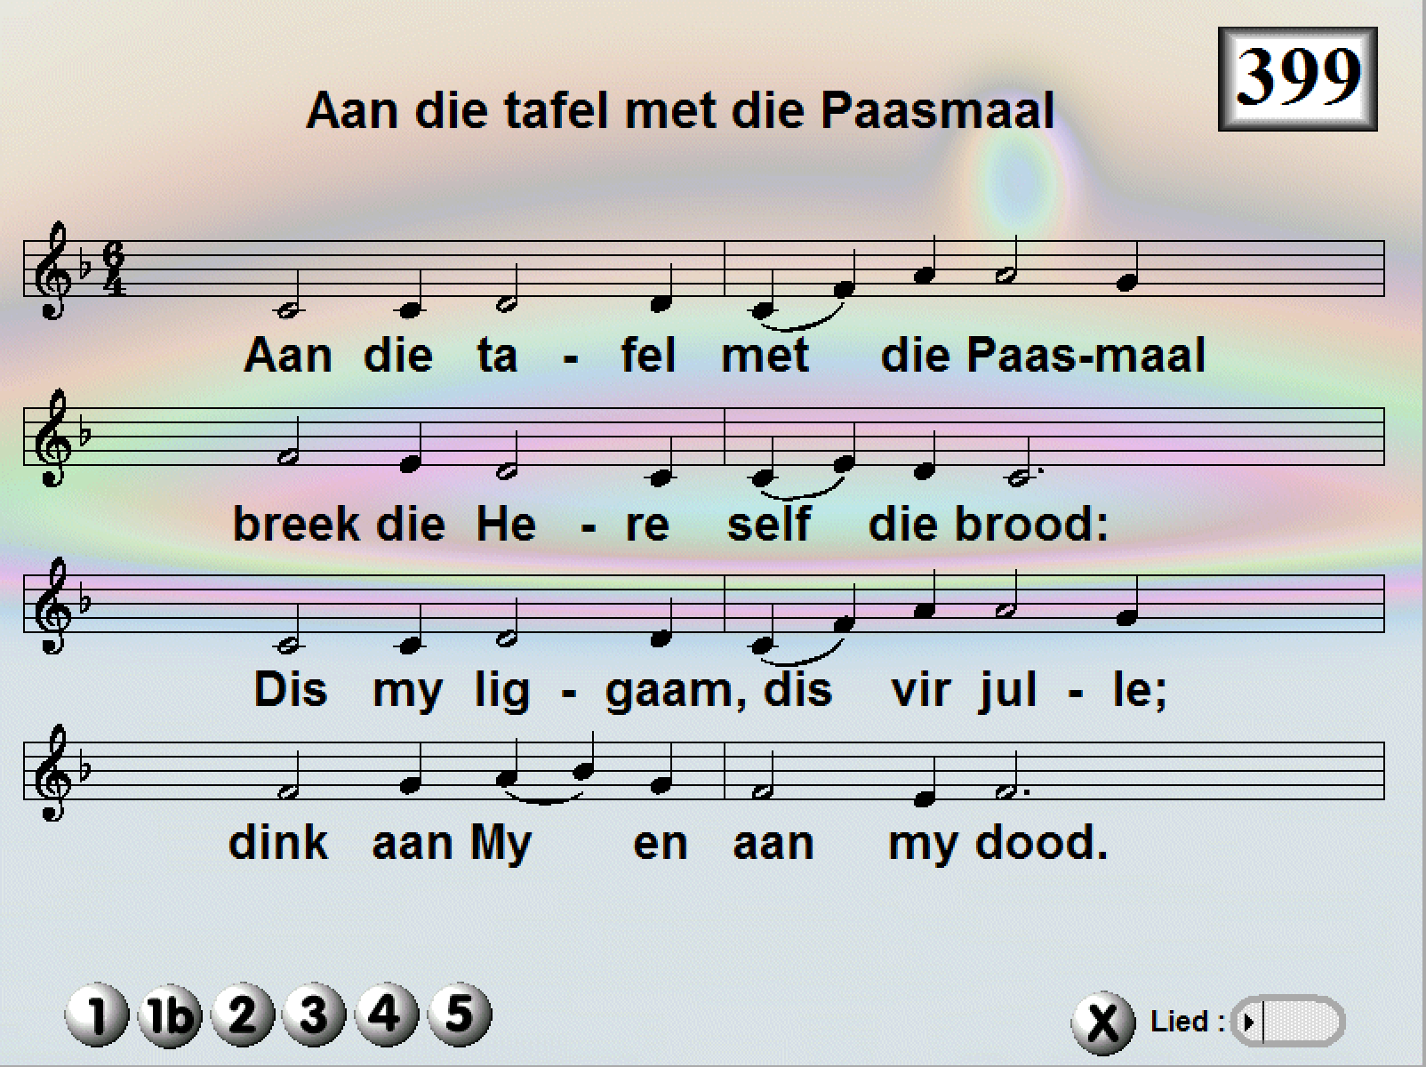

Slide 38
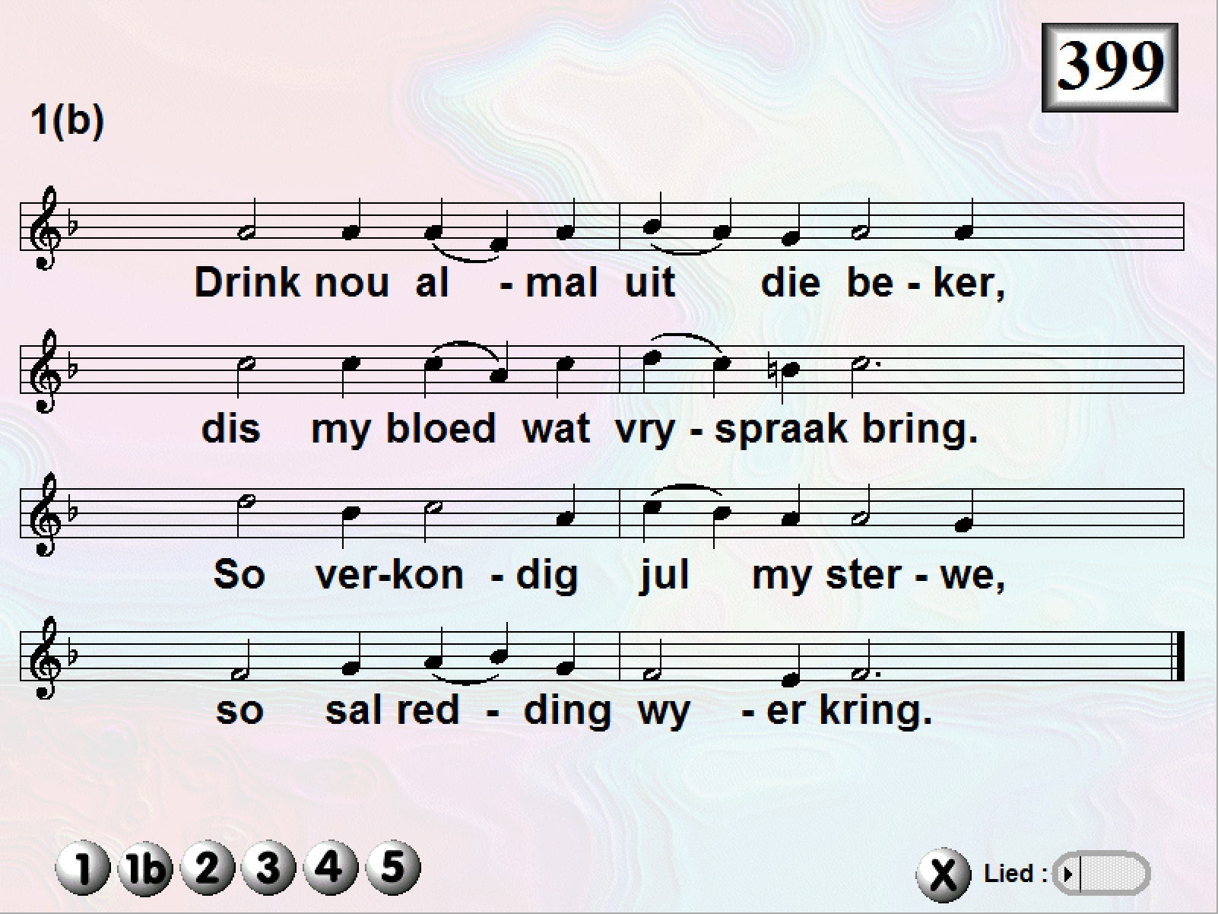

Slide 40
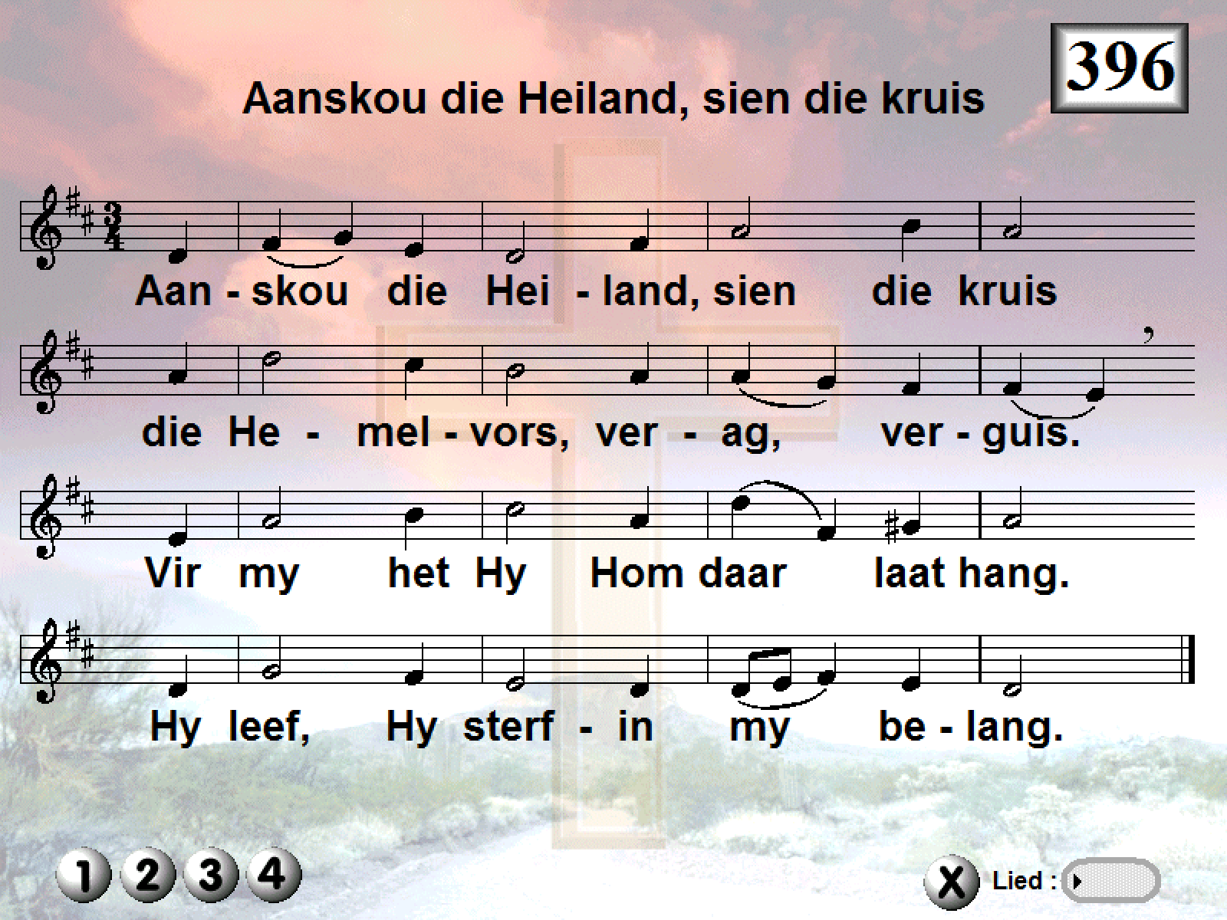

Slide 41
2. Forbid it, Lord, that I should boast
save in the death of Christ, my God!
All the vain things that charm me most,
I sacrifice them through his blood.

Slide 42
3. Vir al my skuld het Hy betaal;
vir my in helle-angs gedaal.
Sy kruis, sy liefde onbegrens,
ontsluit in my ’n nuwe mens.

Slide 43
4. Were the whole realm of nature mind,
that were a present far too small.
Love so amazing, so divine,
demands my soul, my life, my all

